Slide 1

DeepLAW

Slide 2

Imagine situation

Slide 3
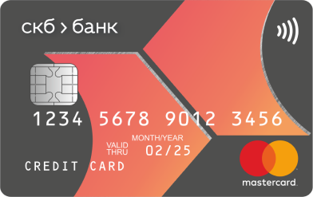
Imagine situation

Slide 4


Imagine situation

Slide 5



Imagine situation
БАНК

Slide 6
Imagine situation

Slide 7

Imagine situation

Slide 8
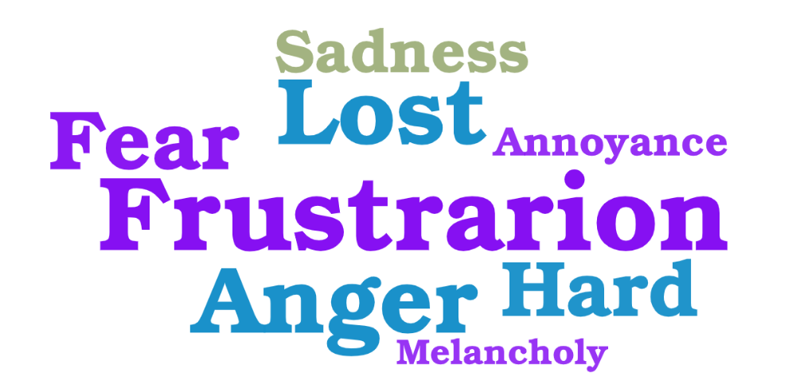
What would you feel?

Slide 9

WE HAVE THE SOLUTION!
Hello! My name is DeepLAW. I was created to serve people and help them with solving legal problems.

Slide 10
EASY TO USE
I have a problem with my card…
Here what the law says about your problem and what you should do next…

Slide 11


HOW TO ACHIEVE THIS
+
=
GPT-3

Slide 12


Multiple connections

Slide 13





Possible users

Slide 14
DeepLAW
IMPROVE THE WORLD TODAY

